Slide 1
Tableau Desktop Certification
Data Analytics

Slide 2


























Common Charts
Data Views
Hierarchies
Data Structures
Basic Navigation
Dashboards
Data Stories
Calculations
Advanced
Charts
Certification Springs
Blending
Done
You are here

Slide 3
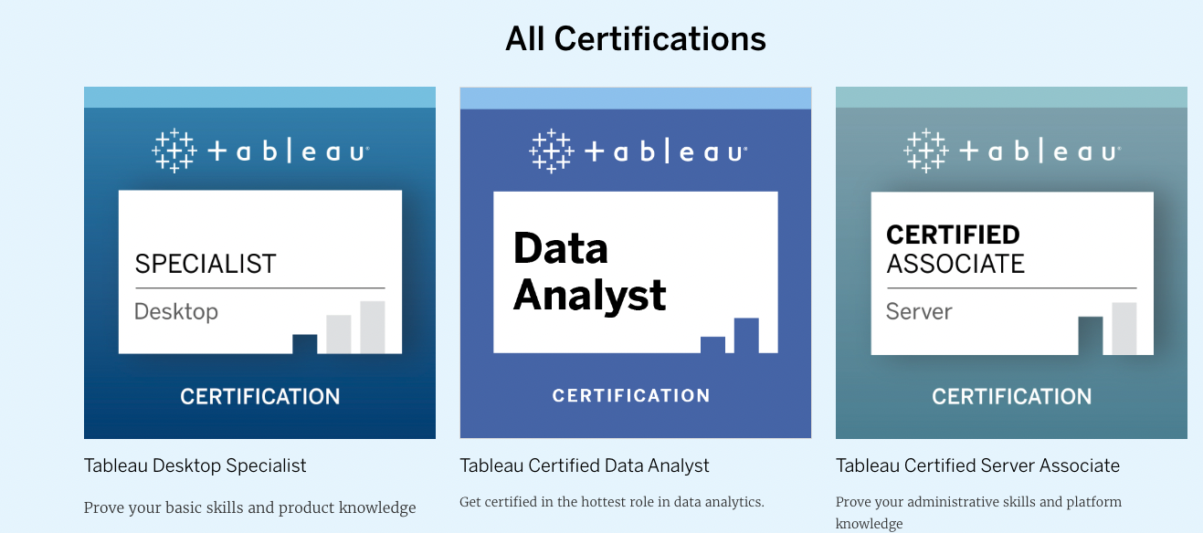
Tableau Certifications

Slide 4
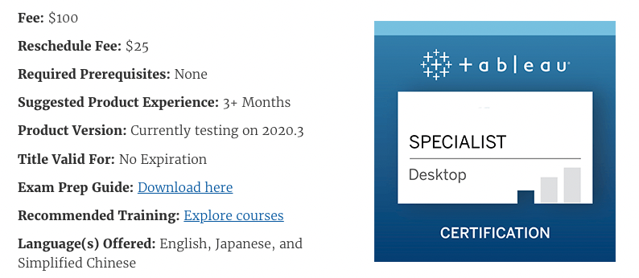
Tableau Desktop Specialist Certification

Slide 5
Format
Prerequisites
There are no required prerequisites for this exam. Everyone learns differently and every day use of Tableau varies. Recommendations for learning resources and experience with the product are guidelines, not requirements.
Exam Format
Time Limit: 60 minutes
Question Format: Multiple choice, multiple response
Number of Questions: 45 (40 scored, 5 unscored)
Passing Score: The passing scaled score for this exam is 750.
Language(s) Offered: English, Japanese, and Simplified Chinese.
Exam Delivery Method: Testing center and online delivery are both available. Learn more about the check-in process and testing experience for each method

Slide 6
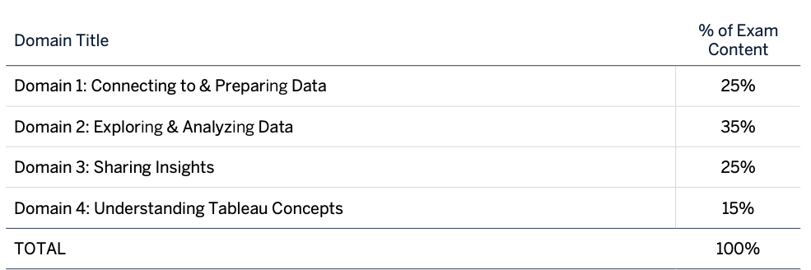
Test Rubric

Slide 7
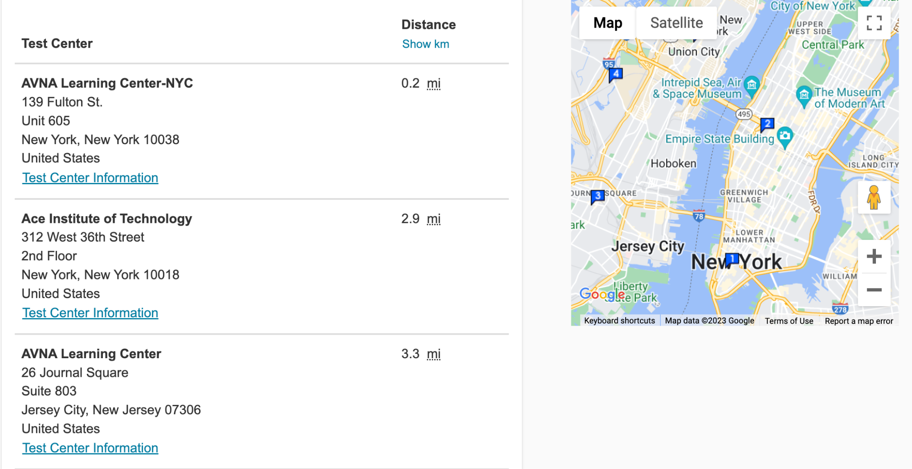
Pearson Authorized Test Centers

Slide 8
Testing space requirements:
The place where you’ll take your exam is one of your most crucial decisions. See below for general information or visit the online testing guide for more specifics.
General:
Choose an enclosed, private space. An ideal testing space will allow you to close all doors to avoid interruptions, since no one else may enter or even pass through your space once you’ve started your exam.
Make sure it’s well-lit, but be aware that too much background light (natural or electric) could create visibility issues for your proctor.
Avoid testing near windows or glass partitions to prevent others from viewing your screen.
Be prepared to take photos of your testing space during check-in.
Monitor and webcam:
You may only use one monitor during your exam. If using an external monitor, your laptop lid must be closed. The use of touchscreen technology is prohibited.
Position your monitor to face you directly and stay within the webcam’s view throughout your exam. No one else may appear through the webcam during the exam and no one else’s voice should be heard.
Desk/workspace:
Clear your desk/workspace of all personal and preparatory items, except for those allowed by your exam program.
Keep your mobile phone in the room where you’re testing, but out of arm’s reach.

Slide 9
ID requirements for testing online
Make sure you have acceptable ID
Before testing online, you’ll need to provide identification (ID) that meets the requirements outlined below.
All IDs must be valid government-issued originals (i.e., not a photocopy)
IDs must include the test-taker’s name and a recent, recognizable photo
The first and last name on the ID must match the first and last name used to register for the exam
Acceptable forms of ID:
International travel passport
Driver's license
Identification card (national, state or province ID card)
Alien registration card (green card or permanent resident/visa)
Unacceptable IDs:
Restricted IDs*, including the U.S. Department of Defense (DoD) Common Access Card (CAC) or certain secure access IDs
IDs from countries where OnVUE delivery is restricted: North Korea, Cuba, Syria, Sudan, Iran and the Sevastopol/Crimea region of Ukraine.

Slide 10
STEP 1. Do any last-minute prep
Be sure your computer and internet pass the pre-exam system test. Clear your desk/workspace of prohibited items and prep your equipment. Get your ID ready to present.
STEP 2. Check in
You can begin the check-in process up to 30 minutes before to 15 minutes after your appointment time.
STEP 3. Start your exam
While testing, it’s best to focus on the questions and not get distracted. Observe all the environmental and behavioral rules. If you need help during your exam, use the chat icon to request assistance.

Slide 11
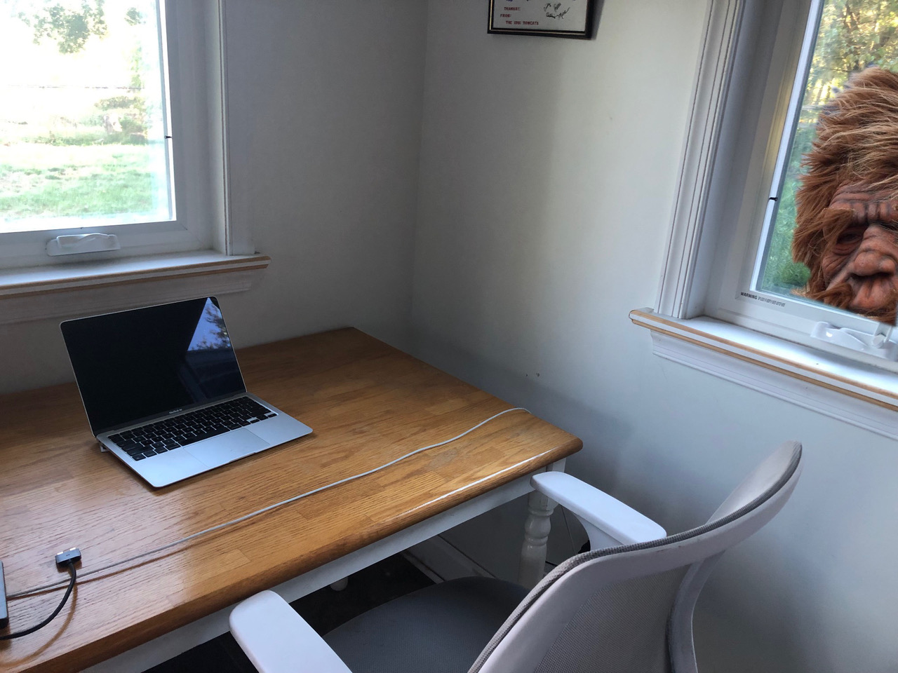
Test Space

Slide 12
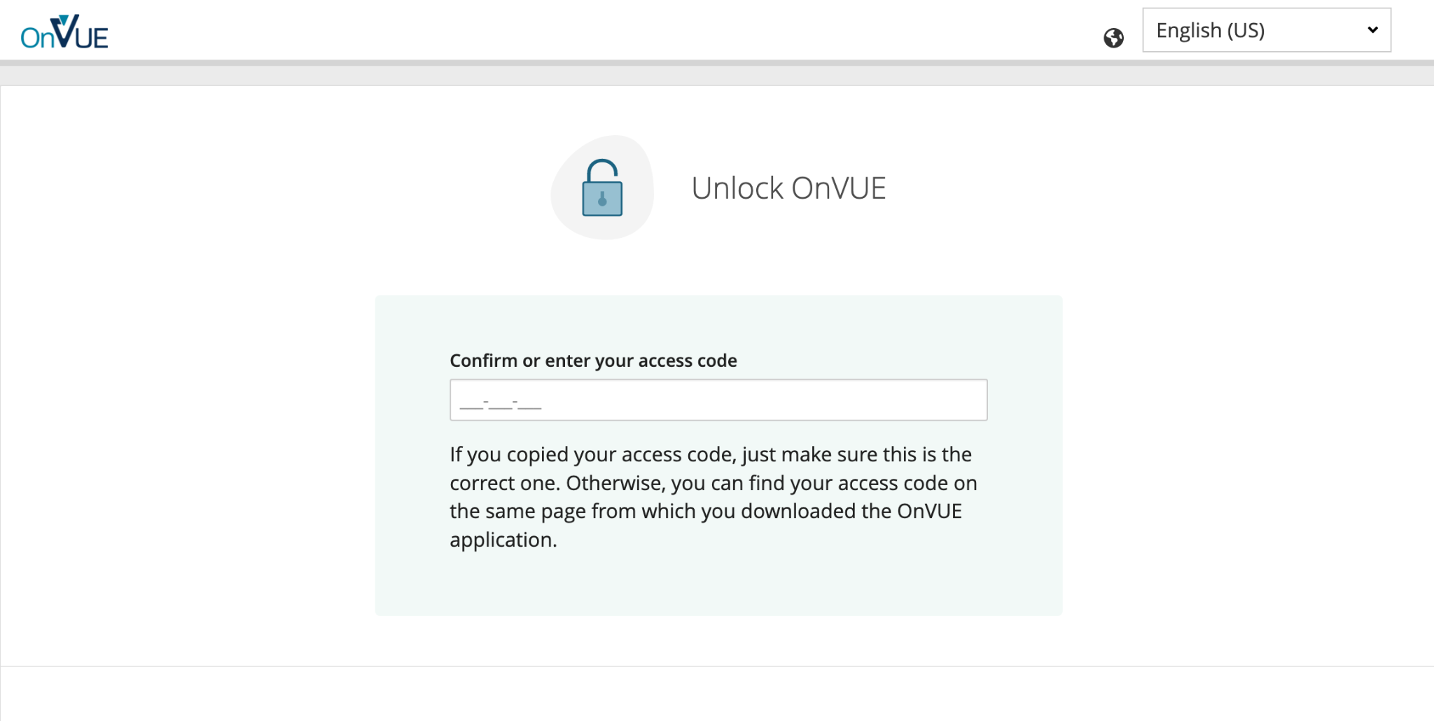
The OnVue Secure Browser

Slide 13
Domain 1: Connecting to & Preparing Data
1.1 Create live connections and extracts
1.1.1 Create a live connection to a data source 1.1.2 Explain the differences between using live connections versus extracts 1.1.3 Create an extract 1.1.4 Save metadata properties in a .TDS 1.1.5 Create a data source that uses multiple connections
1.2 Create and manage the data model
1.2.1 Add relationships to a data source 1.2.2 Add joins and unions 1.2.3 Explain when to use a join versus a relationship
1.3 Manage data properties
1.3.1 Rename a data field 1.3.2 Assign an alias to a data value 1.3.3 Assign a geographic role to a data field 1.3.4 Change data type for a data field (number, date, string, Boolean, etc.) 1.3.5 Change default properties for a data field (number format, aggregation, color, date format, etc.)

Slide 14
Live vs. Extract
Live connection
Extract
A data source that contains direct connection to underlying data
Tableau makes queries directly against the data source
Won’t work if not connected
Need to enter credentials
Saved subsets of data
Better performance than live
Full refresh/incremental refresh (only adds new rows)
Works without connection
No credentials

Slide 15
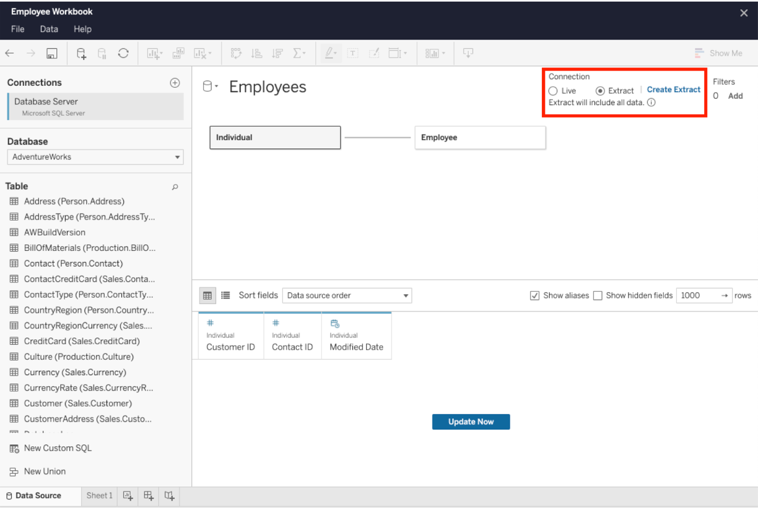

Slide 16
Workbooks (.twb) – Tableau workbook files have the .twb file extension. Workbooks hold one or more worksheets, plus zero or more dashboards and stories.
Bookmarks (.tbm) – Tableau bookmark files have the .tbm file extension. Bookmarks contain a single worksheet and are an easy way to quickly share your work.
Packaged Workbooks (.twbx) – Tableau packaged workbooks have the .twbx file extension. A packaged workbook is a single zip file that contains a workbook along with any supporting local file data and background images. This format is the best way to package your work for sharing with others who don’t have access to the original data.
Extract (.hyper or .tde) – Depending on the version the extract was created in, Tableau extract files can have either the .hyper or .tde file extension. Extract files are a local copy of a subset or entire data set that you can use to share data with others, when you need to work offline, and improve performance.
Data Source (.tds) – Tableau data source files have the .tds file extension. Data source files are shortcuts for quickly connecting to the original data that you use often. Data source files do not contain the actual data but rather the information necessary to connect to the actual data as well as any modifications you've made on top of the actual data such as changing default properties, creating calculated fields, adding groups, and so on.
Packaged Data Source (.tdsx) – Tableau packaged data source files have the .tdsx file extension. A packaged data source is a zip file that contains the data source file (.tds) described above as well as any local file data such as extract files (.hyper or .tde), text files, Excel files, Access files, and local cube files. Use this format to create a single file that you can then share with others who may not have access to the original data stored locally on your computer.

Slide 17
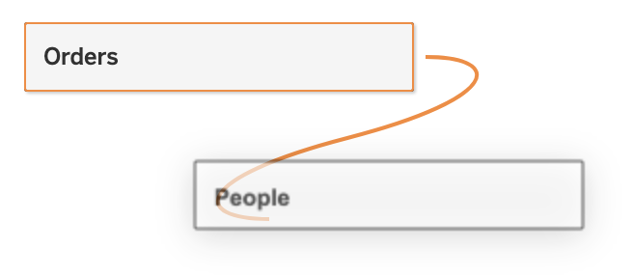
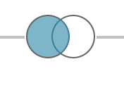
Relationship vs. Join
Relationship
Join
Logical layer
Noodles
Flexible
Good with different levels of aggregation
Physical layer
Rings
Rigid
Trouble with aggregation at different levels of detail

Slide 18
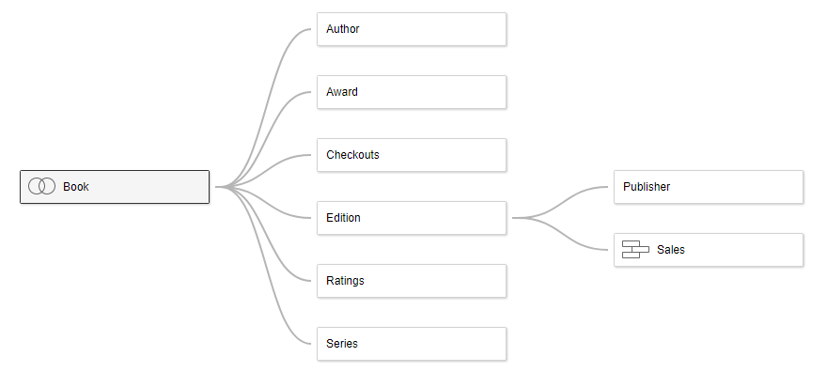
Relationships

Slide 19
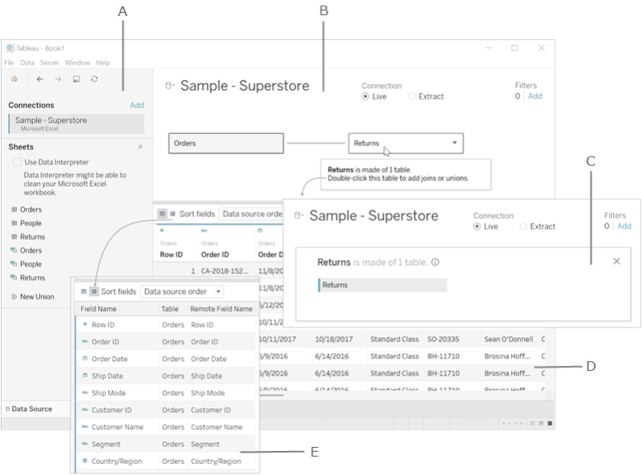
A. Left pane - Displays the connected data source and other details about your data.
B. Canvas: logical layer - The canvas opens with the logical layer, where you can create relationships between logical tables.
C. Canvas: physical layer - Double-click a table in the logical layer to go to the physical layer of the canvas, where you can add joins and unions between tables.
D. Data grid - Displays first 1,000 rows of the data contained in the Tableau data source.
E. Metadata grid - Displays the fields in your data source as rows.

Slide 20
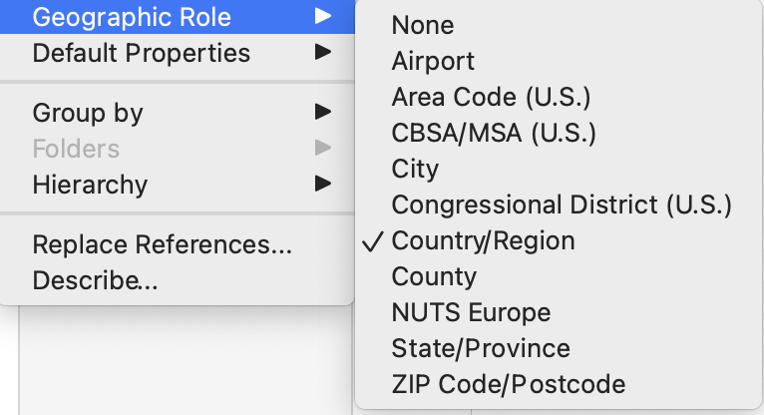
Geographic Roles

Slide 21
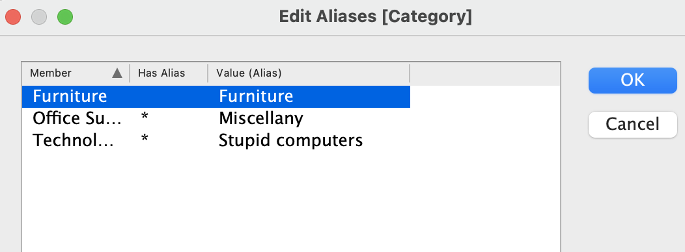
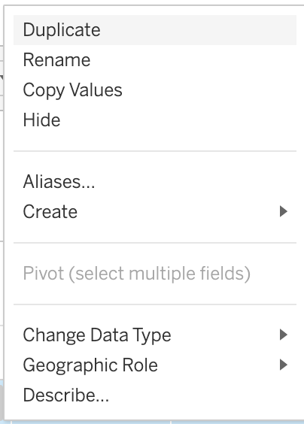
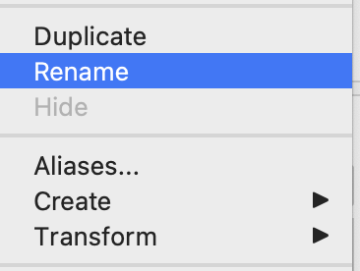
Alias and Rename
Aliases are for discrete categories
You can rename a variable by right clicking on its name
or in the metadata grid on the data connection

Slide 22
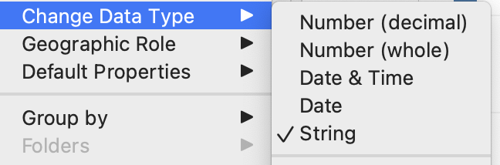
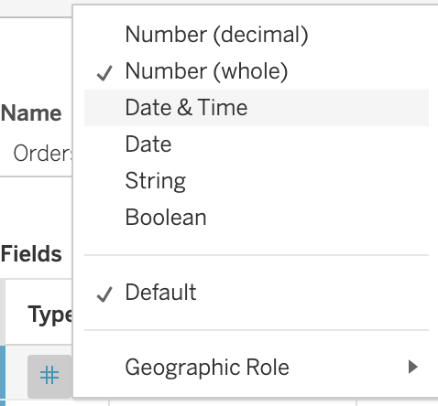
Change Data Type
You can change data type from the data pane
or
the metadata grid on the data connection page

Slide 23
Knowledge Check
Connecting multiple tables on the logical level is what kind of connection?
Why is a data extract preferable to a live data connection?
To change a data type in the metadata grid you should click on what?
What is stored in a .tds file?
Can a measure be discrete?
Is time zone a geographic role?

Slide 24
Domain 2: Exploring & Analyzing Data
2.1 Create basic charts
2.1.1 Create a bar chart
2.1.2 Create a line chart
2.1.3 Create a scatterplot
2.1.4 Create a map using geographic data
2.1.5 Create a combined axis chart
2.1.6 Create a dual axis chart
2.1.7 Create a stacked bar
2.1.8 Create a density map
2.1.9 Create a chart to show specific values (crosstab, highlight table)
2.2 Organize data and apply filters
2.2.1 Create groups by using marks, headers, and the data pane
2.2.2 Create sets by using marks and the data pane
2.2.3 Organize dimensions into a hierarchy
2.2.4 Add a filter to a view
2.2.5 Add a date filter
2.3 Apply analytics to a worksheet
2.3.1 Add a manual or a computed sort
2.3.2 Add a reference line
2.3.3 Use a quick table calculation
2.3.4 Use bins and histograms
2.3.5 Create a calculated field (e.g. string, date, simple arithmetic)
2.3.6 Explain when to use a parameter
2.3.7 Display totals on a worksheet

Slide 25
Charts
Bar charts - show your categorical data with rectangular bars that have heights or lengths proportional to the values that they represent.
Line charts - display your data as a series of points called 'markers' connected by straight line segments.
Scatterplot - plots your data using two measures that plot on each axis.
Geographical map charts - display your geographical data by categories or values.
Combined axis charts - display your data by merging two or more measures into a single access so you can use multiple measures on the same chart.
Dual axis charts - display your data using multiple mark types and shared axes.
Stacked bar chart - display your data in a simple bar chart with segmented bars that represent distinct values of one data field on one axis.
Crosstab - also known as a text table made up of one or more dimensions and one or more measures.

Slide 26
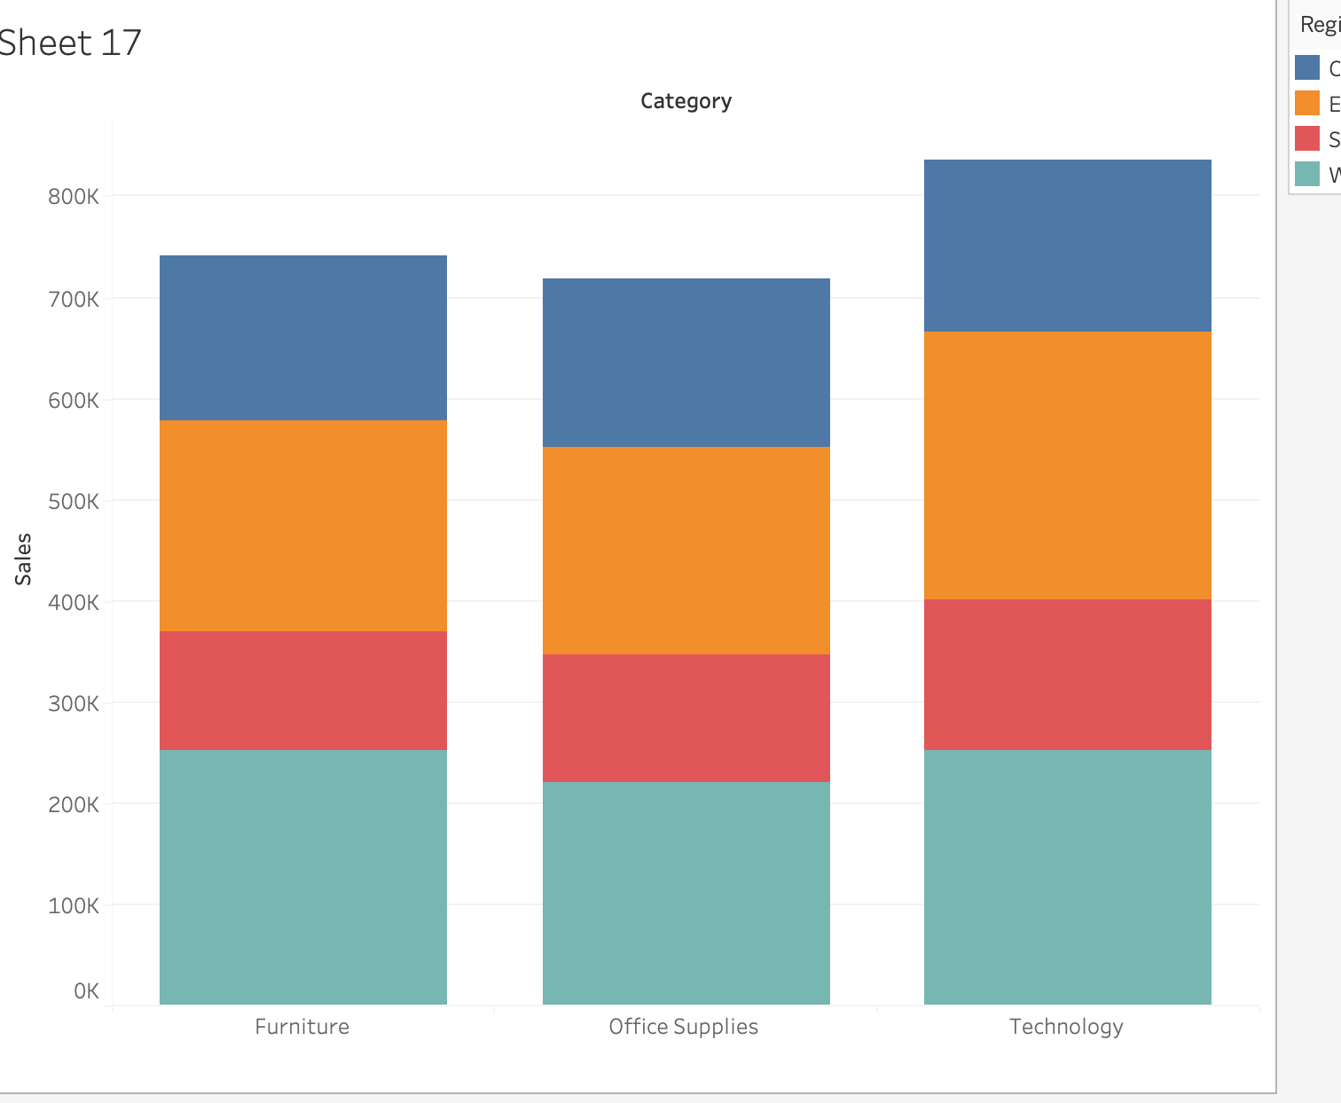
Creating a Stacked Bar
2 dimensions
(1 x-axis, 1 color)
1 measure

Slide 27
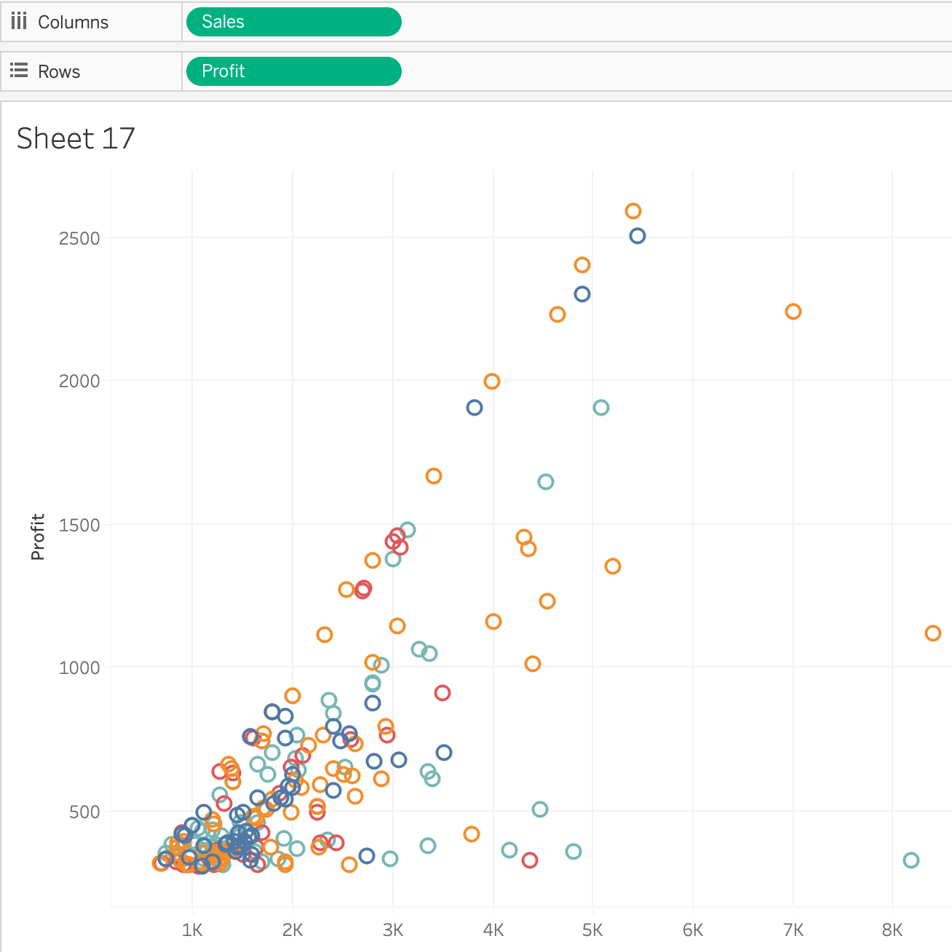
Creating a Scatter Plot

Slide 28
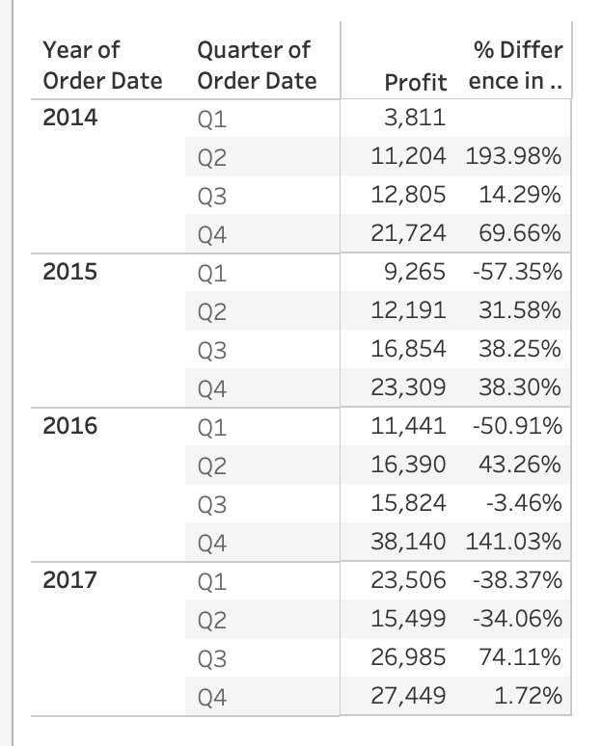
Crosstab
aka text tables

Slide 29
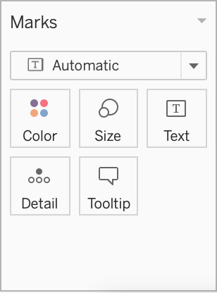
Marks
Color
Size
Text
Detail
Tooltip
Shape
Angle

Slide 30
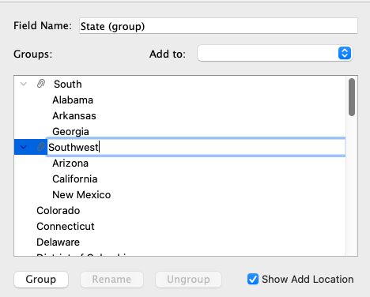
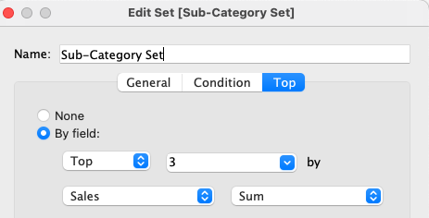
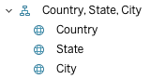
Groups, Sets, Hierarchies

Slide 31
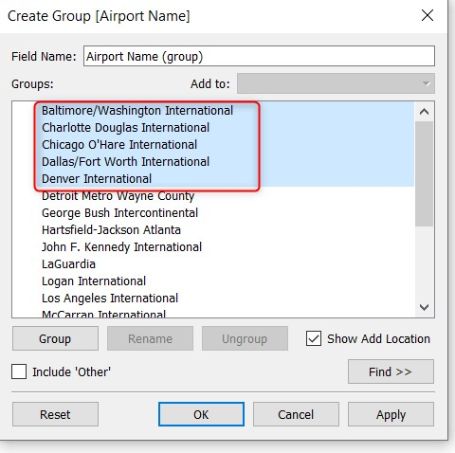
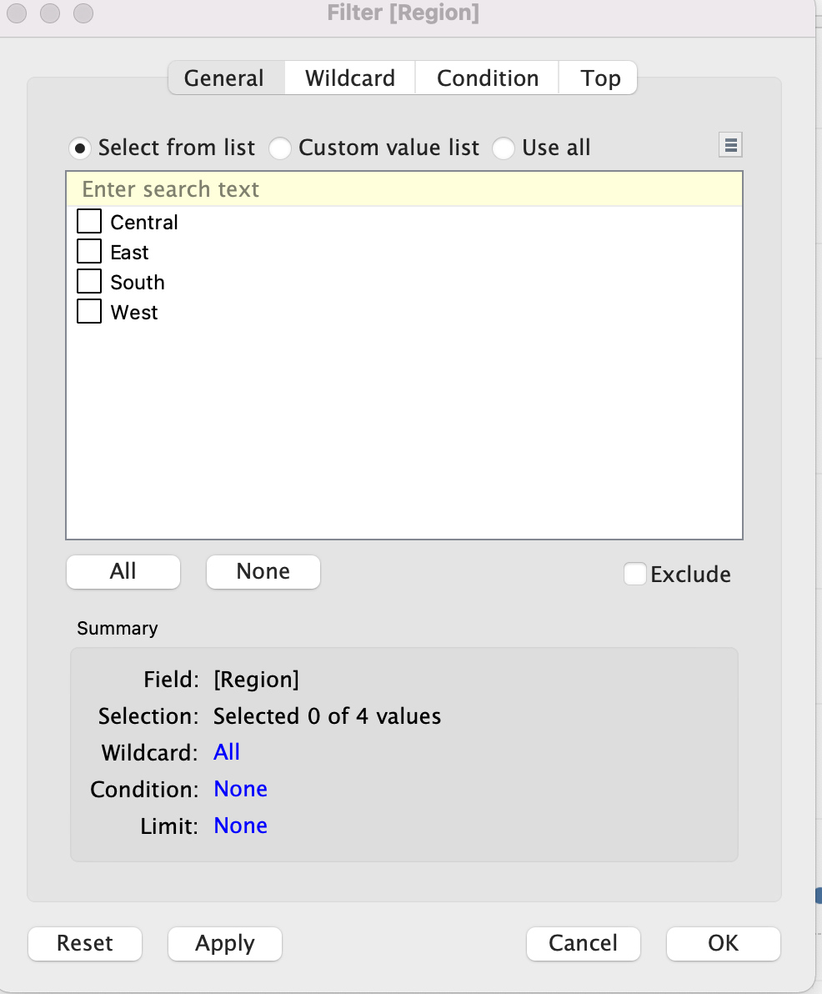
Groups vs. Sets
Groups - dimension categories that can be “collapsed” into one
Sets - collections with ‘membership’, either selected or based on criteria

Slide 32
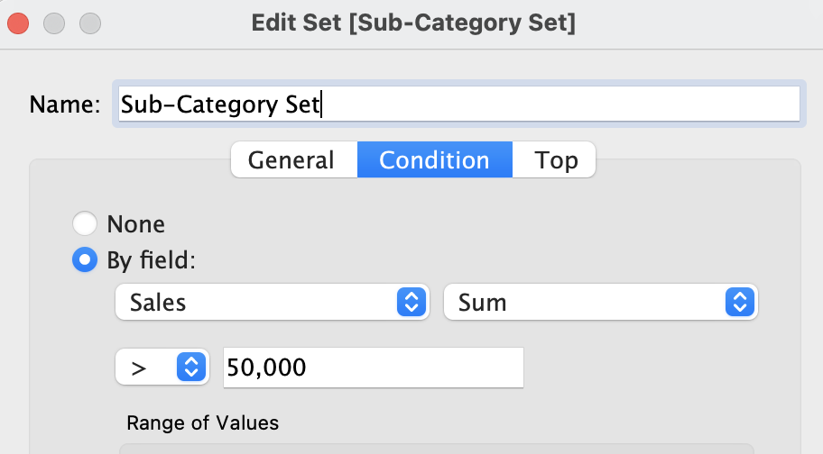
Sets
In
Out

Slide 33
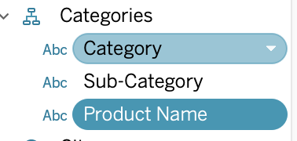
Hierarchies

Slide 34
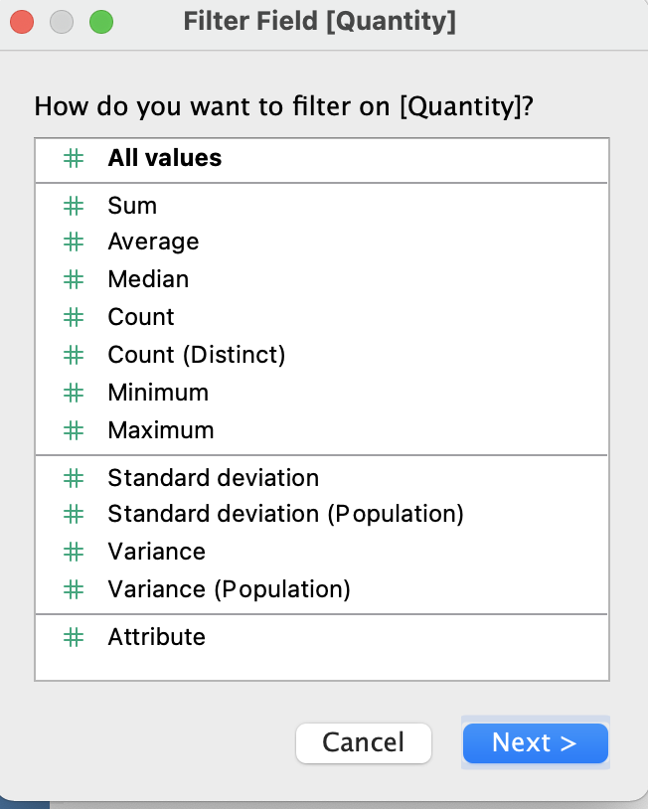
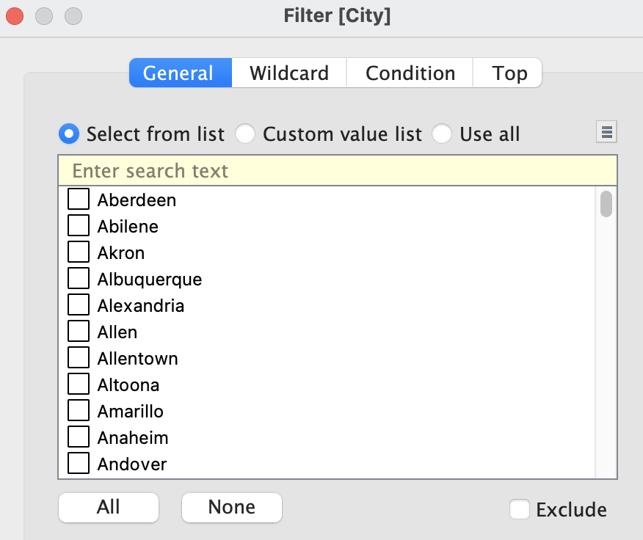
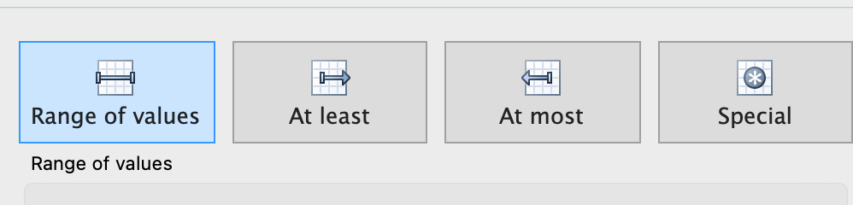
Filters

Slide 35
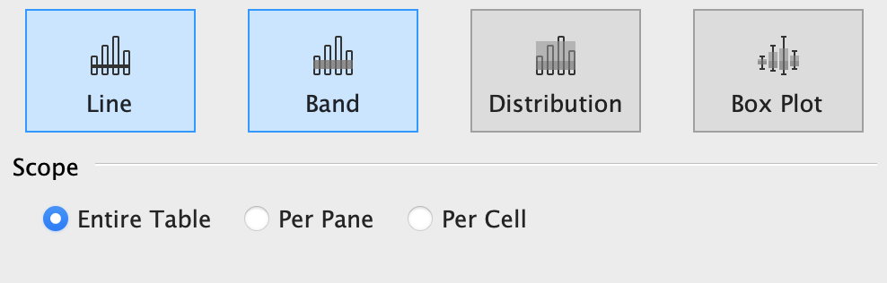
Reference Lines/Bands

Slide 36
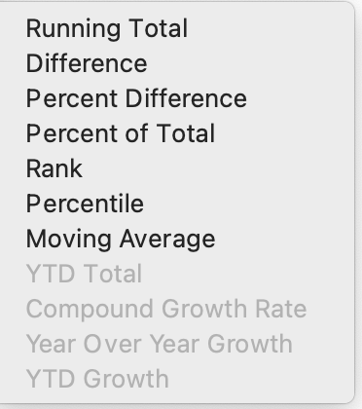
Quick Table Calculations

Slide 37
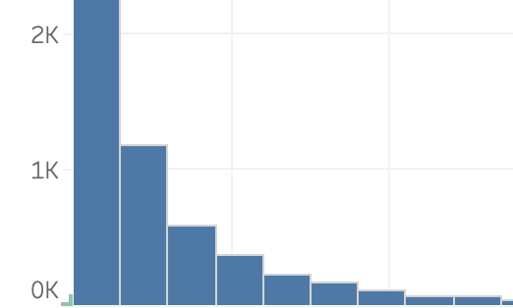
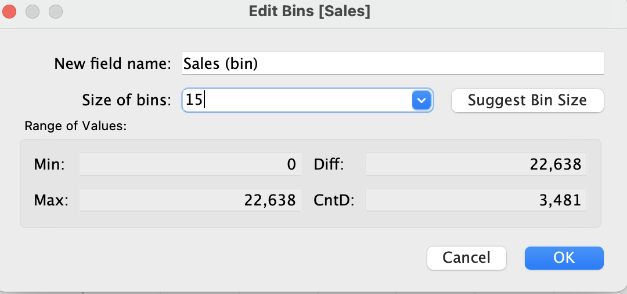
Bins and Histograms

Slide 38
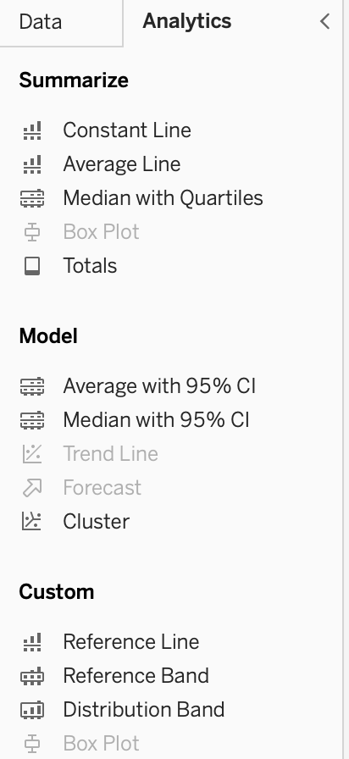
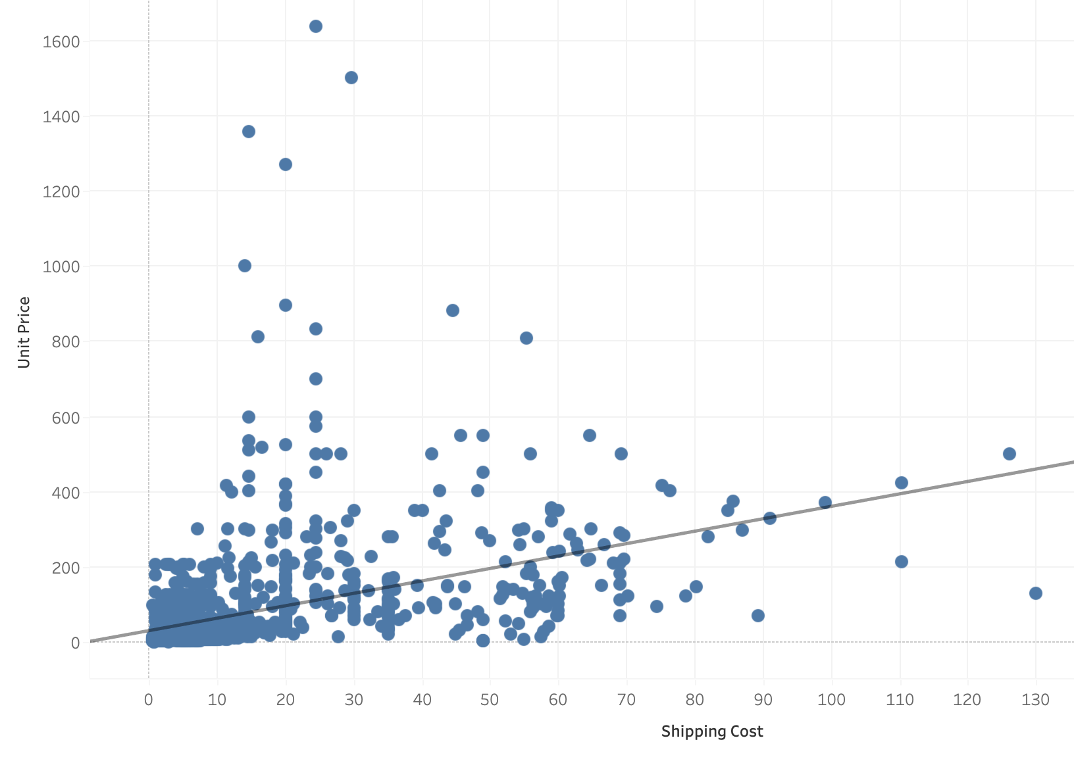
Analytics

Slide 39
Knowledge Check
How can you change the size of all the marks on sheet?
What does ‘bin size’ mean?
What are the two types of sets?
Why would you use hierarchies?
What’s a crosstab in Tableau?
What kind of data do you need for a scatter plot?
What’s a highlight table?

Slide 40
Domain 3: Sharing Insights
3.1 Format view for presentation
3.1.1 Use color from the marks card
3.1.2 Configure fonts
3.1.3 Format marks as shapes
3.1.4 Configure viz animations
3.1.5 Change size of marks
3.1.6 Show and hide legends
3.2 Create and modify a dashboard
3.2.1 Add worksheets to a dashboard
3.2.2 Add interactive elements for consumers (e.g. show filters, data highlighter, tooltips)
3.2.3 Add dashboard actions (e.g. filter action, highlight action, parameter control, URL action)
3.2.4 Configure a dashboard layout and create device-specific dashboards
3.2.5 Create a story and a story point
3.3 View and share workbook data
3.3.1 Share a workbook (e.g. twbx as a PDF or an image, publish to Tableau Server)
3.3.2 View and export underlying data
3.3.3 Export to Microsoft PowerPoint

Slide 41
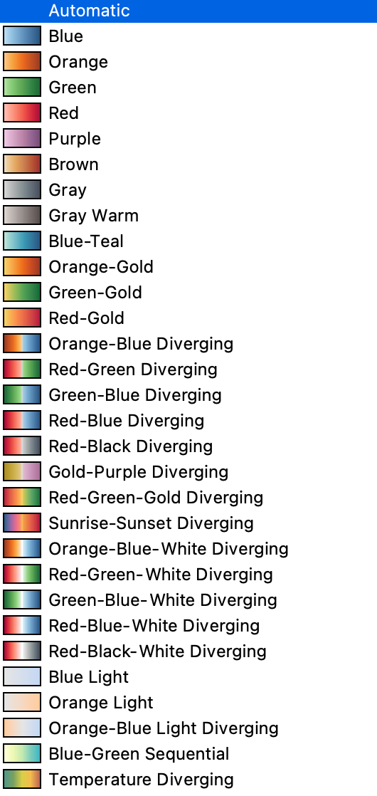
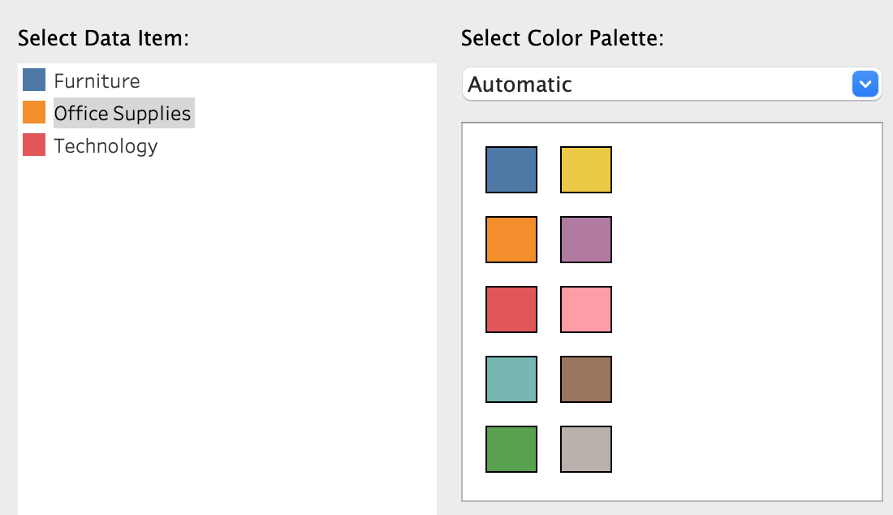
Changing Colors

Slide 42
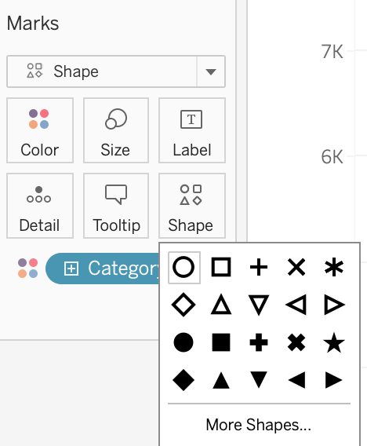
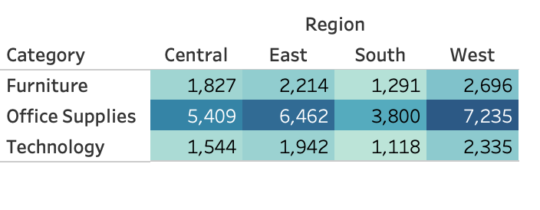
Shapes and Colors

Slide 43
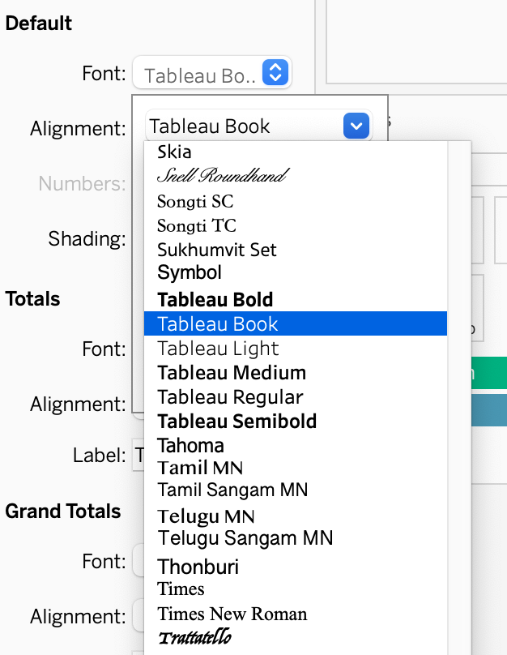
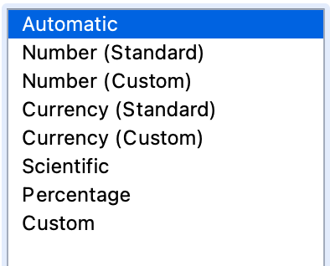
Formatting

Slide 44
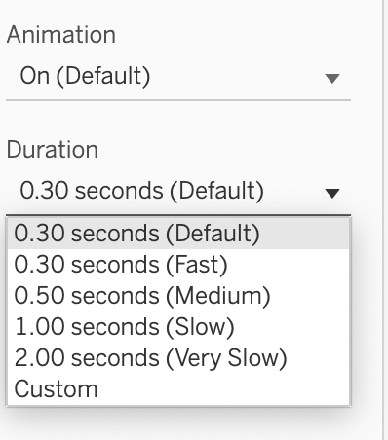
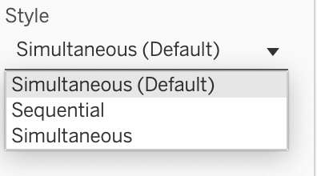
Animations

Slide 45
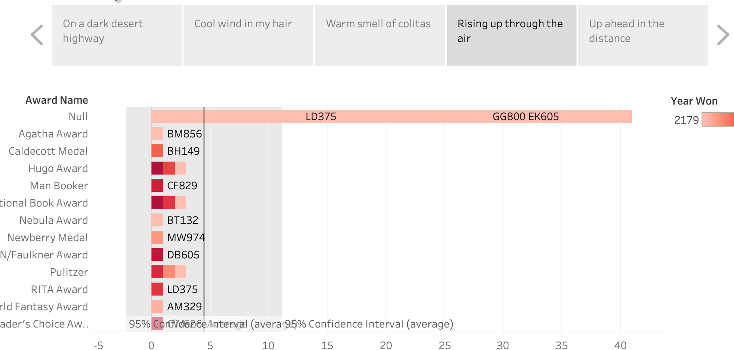
Stories

Slide 46
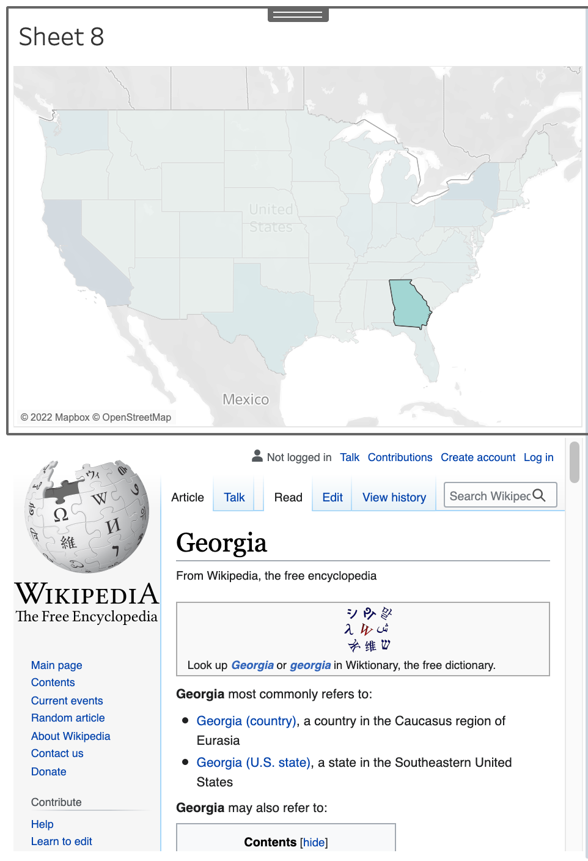
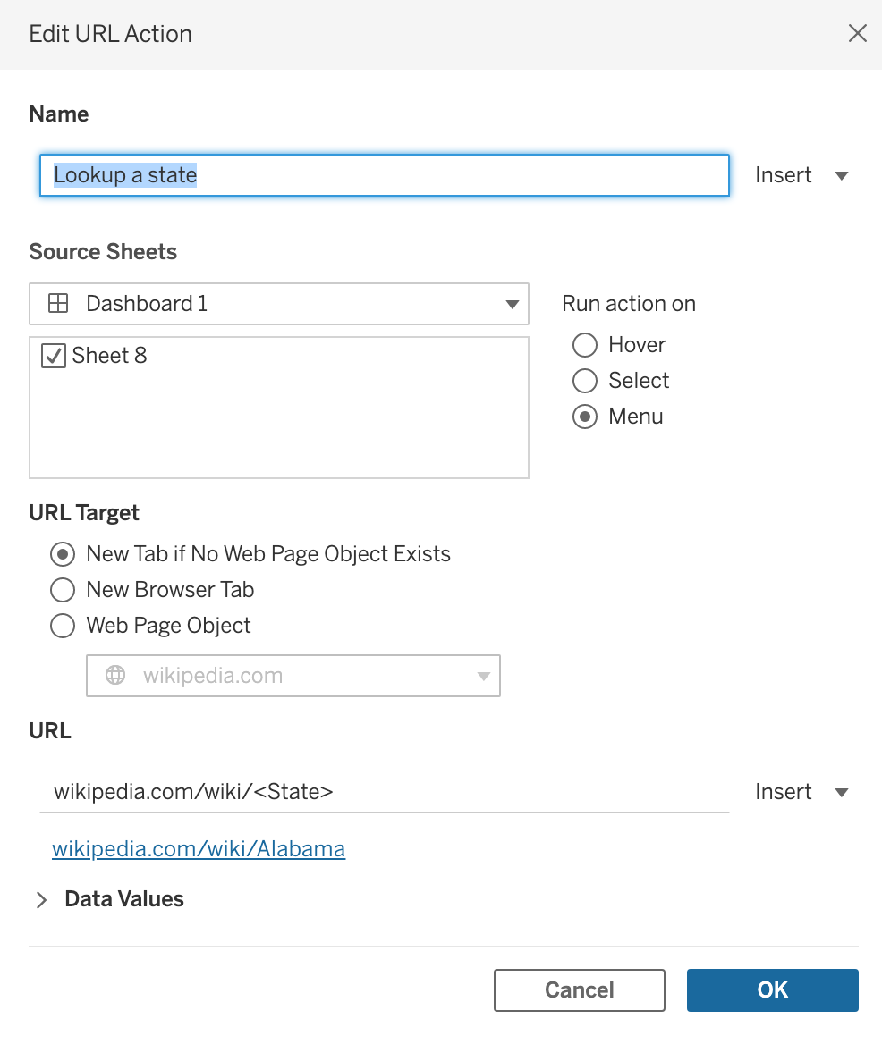
Dashboards
Dashboard URL action

Slide 47
Knowledge Check
What kinds of charts use shapes?
What’s a URL action in a dashboard?
What’s the purpose of a story?
How do you change the font of headers in a crosstab?
What is preserved when you save a workbook as pdf?
What animation parameters can be changed?
How can you change the colors in a stacked bar chart?

Slide 48
Domain 4: Understanding Tableau Concepts
4.1 Understand dimensions and measures
4.1.1 Explain what kind of information dimensions usually contain
4.1.2 Explain what kind of information measures usually contain
4.1.3 Explain the difference between dimensions and measures
4.2 Understand discrete and continuous fields
4.2.1 Explain how discrete fields are displayed
4.2.2 Explain how continuous fields are displayed
4.2.3 Explain the difference between discrete date parts and continuous date values
4.3 Understand aggregations
4.3.1 Explain the default aggregation for measures
4.3.2 Describe how an aggregated measure changes when dimensions are added to a view

Slide 49
Dimensions vs. Measures
Dimensions
Measures
Qualitative
Blue
Quantitative
Green
 | Dimension | Measure
Discrete | strings date parts boolean | bins IDs
Continuous | dates | measured values

Slide 50
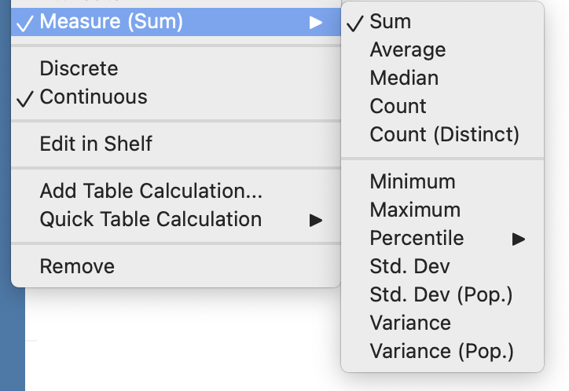
Aggregations

Slide 51
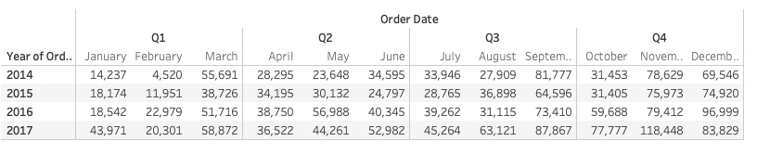
Date Part
Day
Month
Quarter
Year

Slide 52
Knowledge Check
Can dimensions be continuous?
What is a date part?
Can you use percentile for an aggregation?
What is the default aggregation type for a measure?

Slide 53
Practice!

